Slide 1
CONVERGENCE of IT and OT

Slide 2
CONVERGENCE of IT and OT
IT is internet technology
OT is operational technology
IT supports connections to internet along with related data and technology systems
IT always focus on secure DATA FLOW within the organization
IT do not involved in production and logistics of company
IT is responsible only for business data , email, file ,print services, data base etc

Slide 3
CONVERGENCE of IT and OT
OT controls and monitors devices , processes on physical operational systems
OT controls assembly lines, utility distribution network , roadway system..etc
OT is involved in production and logistics of a company
OT is responsible for the devices and processes on industrial equipment such as factory machines ,meters and actuators, distribution devices, SCADA( supervisory control and Data Acquisition)
SCADA system used for controlling, monitoring and analyzing industrial devices
OT uses dedicated networks with specialized communication protocols to connect these devices
These OT networks run completely separately from IT network

Slide 4
CONVERGENCE of IT and OT
If the network connecting factory (automation unit) fails the machine cannot function and production come to stand still.
The company will have negative impact on business that results into loss of million dollars.
On the other hand if the Email server fail it will just irritate the people but it will not have much impact on company

Slide 5
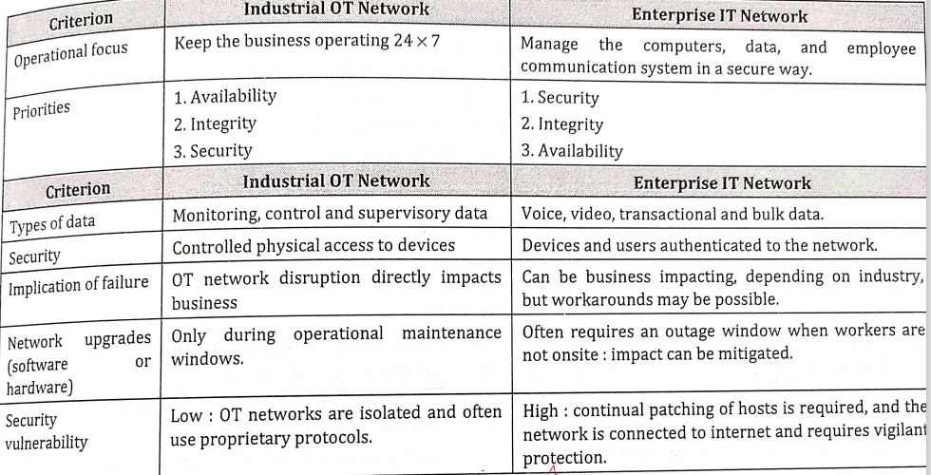
CONVERGENCE of IT and OT

Slide 6
Rise of IT/OT
OT starts adopting Network protocols, technology and transport
IT starts supporting OT requirements
Their convergence leads to….
Reduce amount of infrastructure
Easy to operate network
Flexibility of open standard ETHERNET/IP
Adaptability to new technology
IT understands business outcomes and operational requirements

Slide 7
Deploying QoS
Though priorities of IT and OT are different …..OT should always be given first preference since it will create impact on overall business
IT preferences may be voice or video data
OT preferences may be real time traffic in production
To merge IT OT successfully for efficient system…..IT OT should respect & understand each other priorities

Slide 8
Benefits of merging
More efficient business model
Profitable business
Reduced down time
Lower cost overcall
Improved delivery time

Slide 9
ARCHITECTURE OF IOT

Slide 10
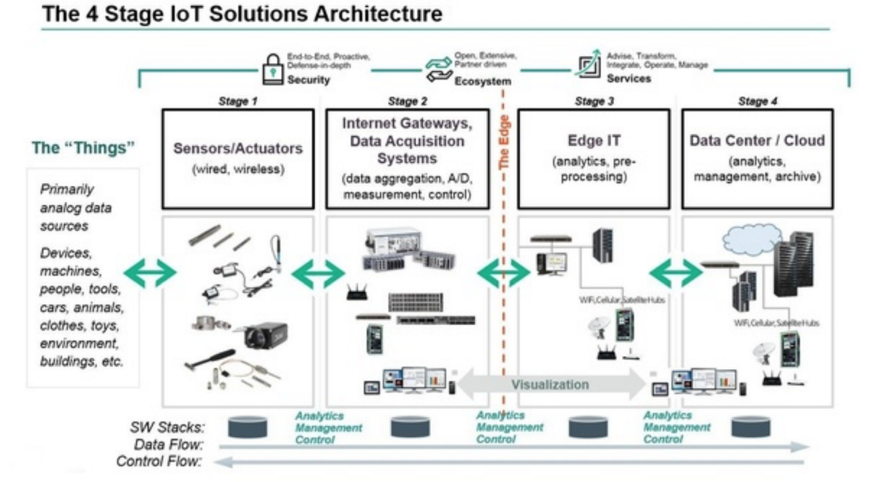
Architecture

Slide 11
IOT Devices (stage 1)
These devices track the data ,record the data as per design
Ex.. Smart watch tracking various parameters of the person wearing it…like pulse ..ECG.. Heart rate….oxygen level.
To do said task these devices are equipped with sensors , actuators
Sensors is electronic circuit that uses RFID, GPS etc
Actuators also an electronic circuit that can read data but it can take action also
Ex…temperature of room changes then actuators automatically SWITCH ON or OFF the air condition system

Slide 12
IOT Gateway (stage 2)
It meant to handle MULTILPLE IOT devices
Ex…SMART CARS of one manufactures running on road. Various data coming from car like Engine Health, Milage Driving Style and Car performance get track by manufacturer
As per the data received he needs to provide maintenance support and break down support to all
It is a big task to manage huge data
IOT Gateway…segregates data from various devices and processes

Slide 13
IOT Gateway (stage 2)
Preprocessing is done on collected data
Only useful information will be sent on further stages
IOT has a capacity to collect granular data
Such highly granular data need not to be sent
IOT gateways ..process these granular data….of various devices …segregates and then send to further stages

Slide 14
Edge Infrastructure( stage 3)
It always try to avoid sending large volume of data over the network
Edge infrastructure run analysis function , prediction based machine learning model
It always try to keep data into sync with other models
Edge infrastructure provides filter device
Filtered data is sent on cloud

Slide 15
Cloud Services( stage 4)
IOT data further analyzed by cloud resources
cloud services take data from IOT devices….processes it and generate meaningful information and actions
It takes data from….
Health monitoring system
Home automation system
Car predictive maintenance

Slide 16
Network Connectivity( stage 5)
All IOT and services and application is incomplete without NETWORK
No internet…no IOT
Various different network protocols are used for seamless operation of IOT
Network connectivity includes…
LTE,2G ,3G, 4G and 5G
Wi-fi ,Bluetooth, ETHERNET
Network communication…on HTTP, CoAP(CONSTRAINED APPLICATION PROTOCOL)
CoAP can allow only constrained devices to get connected to internet

